Slide 1
Positive Behaviour Supports
Teaching Replacement Behaviour for Escape/Avoid

Slide 2
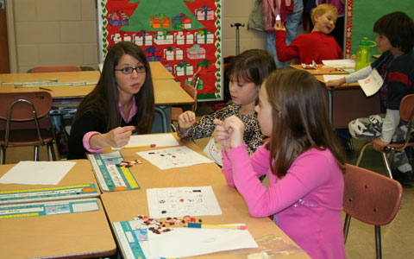
Replacement Behaviour
Appropriate behaviour that serves the same function as a problem behaviour
Need to teach and reinforce the new positive behaviour
If we don’t teach a new behaviour, the student will come up with a new way to get what s/he wants

Slide 3
Teaching Replacement Behaviours
The Basic Sequence
Identify situations where the new skills will be appropriate
Select the skill to teach
Determine the threshold point at which the student is likely to engage in the target behaviour
Prompt the replacement behaviour before s/he is likely to engage in the target behaviour
Reinforce the replacement behaviour - in the early stages of learning shape responses and reinforce approximations

Slide 4
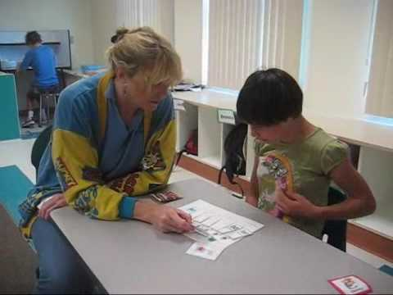
What to teach?

Slide 5
A simplified way of framing the assessment and intervention process
Antecedent | Behaviour | Consequence
Proactive | Teach | Response
You

Slide 6
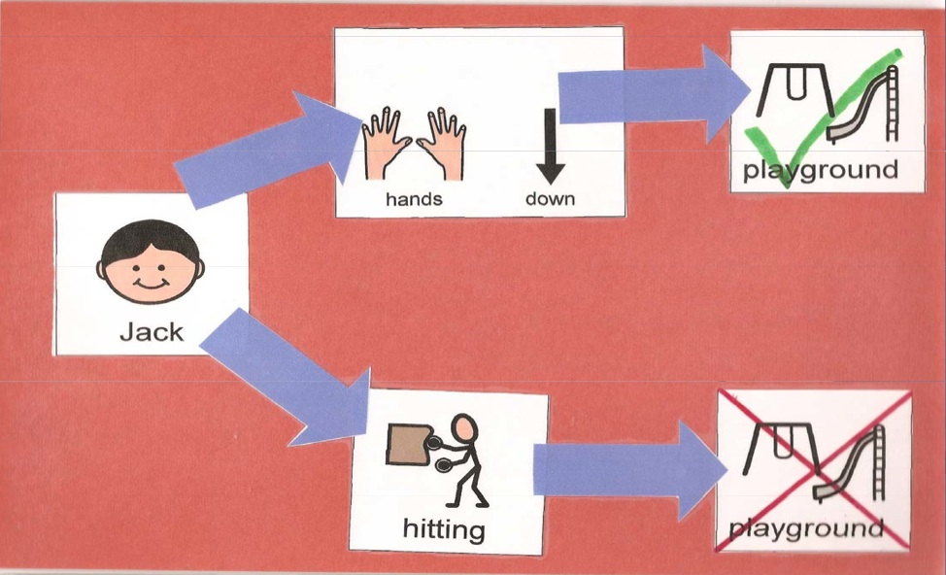
Consequence Map
Visually shows students the connections between their choices and the consequence that will follow
Positive choice above and can be colored coded

Slide 7
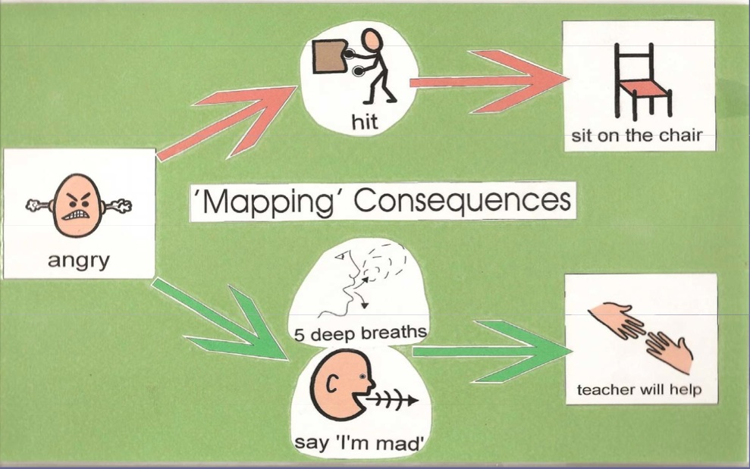
Consequence Map
Premake and laminate
Integrate with other problem solving processes
Include a feeling or natural outcome
Use visuals and/or text

Slide 8
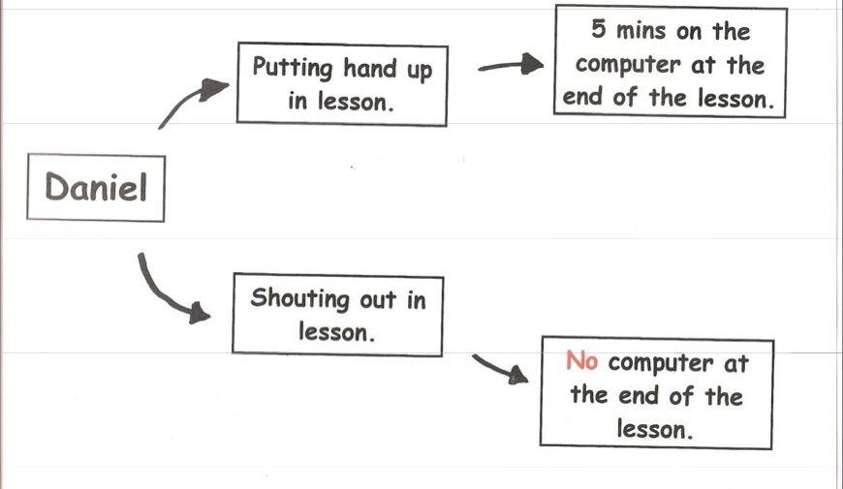
Consequence Map

Slide 9

Self-monitoring
Effective with all ages of students
Students has an active role in all steps
Promotes elements of self-determination
A life skill

Slide 10
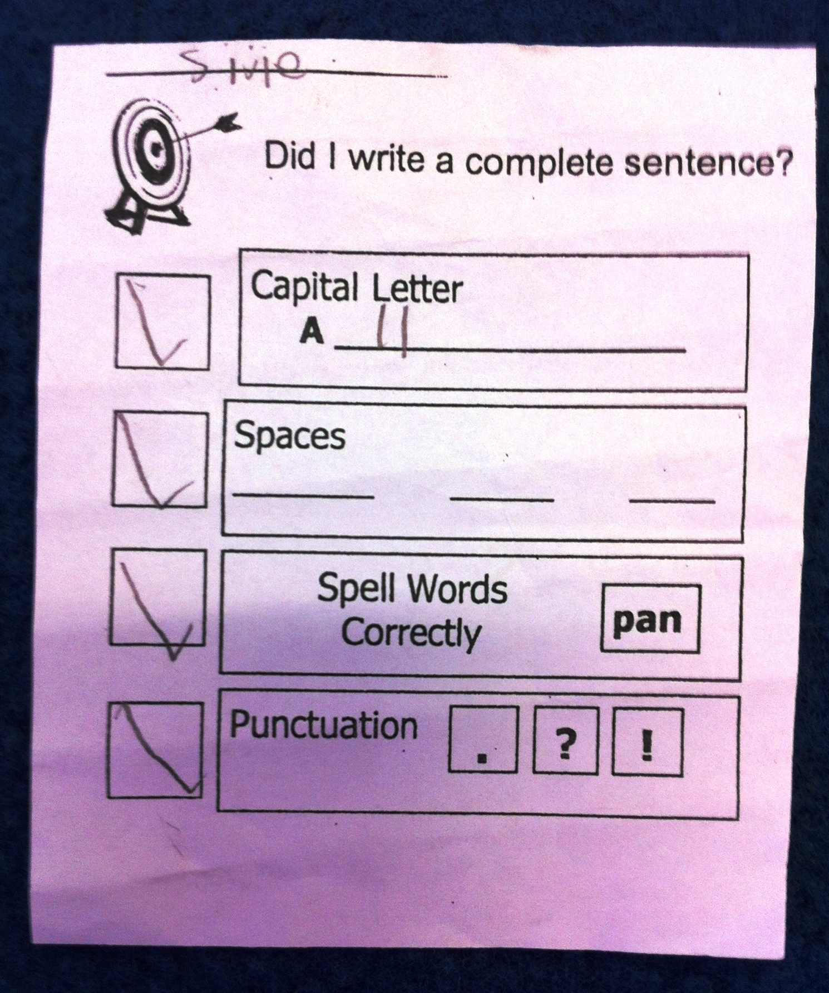
Self-management

Slide 11
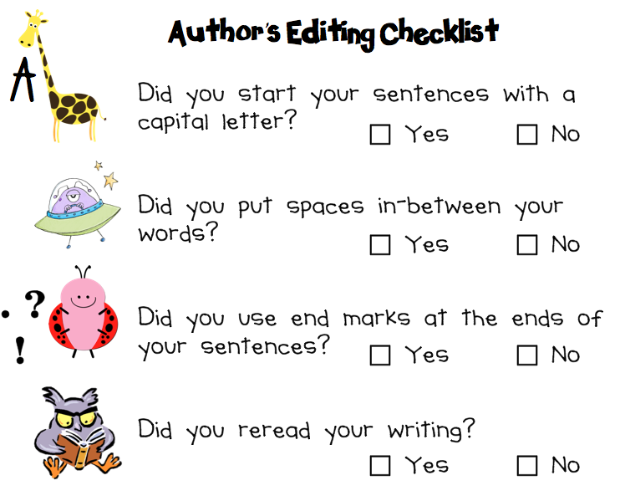
Self management

Slide 12
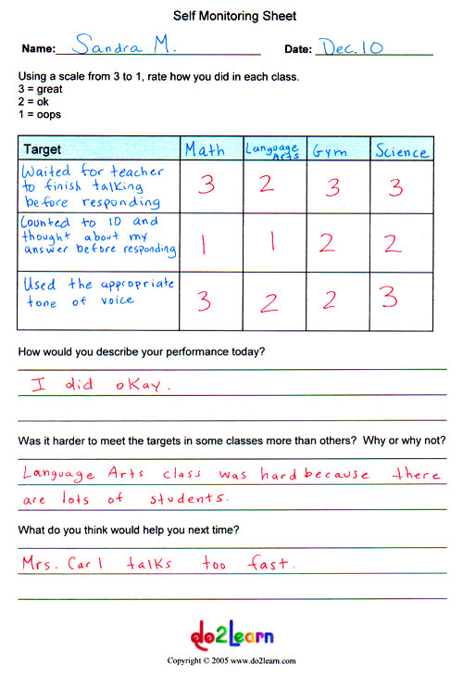
Self management

Slide 13
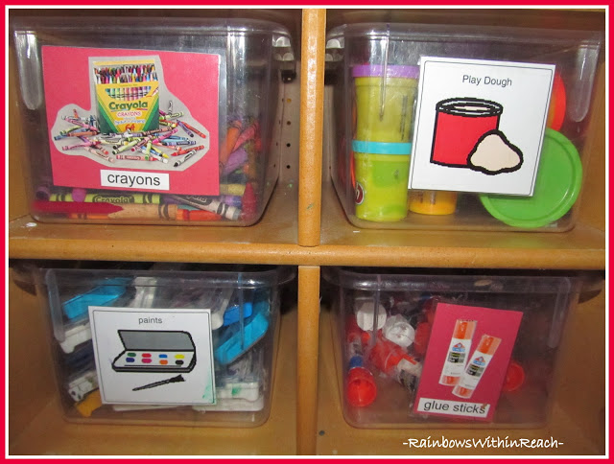
Activity

